Slide 1
TPHA Titration Tips
NewBio

Slide 2
Assay Procedure
1. Sample Dilution (to 1 in 20)
Add 190μL of sample diluent to the first well.
Add 10μL of sample to the same well.
Mix thoroughly.
Note: Kit controls are pre-diluted (i.e., diluted 1 in 20)
2. Test
Add 25μL of Positive Control or Negative Control to designated test wells.
Transfer 25μL of diluted sample from step 1 to test well.
Transfer 25μL of diluted sample from step 1 to control well.
Re-suspend the Test and Control Cells thoroughly.
Add 75μL of Test Cells to test well, and 75μL Control Cells to the control well.
(Final sample dilution is 1 in 80)
Mix wells thoroughly.
Incubate at 15-30°C on a vibration-free surface for 45 - 60 minutes.
Read the agglutination patterns. Patterns are stable if undisturbed

Slide 3
Sample Titration Procedure
9 wells are needed for each sample.
1. Sample Dilution (to 1 in 20)
Add 190μL of sample diluent to a well.
Add 10μL of sample to the same well.
Mix thoroughly.
Note: Kit controls are pre-diluted (i.e., diluted 1 in 20)
2. Titration
Leave the first well empty, add 25μL of diluent all other wells in the sequence.
Transfer 25μL from step 1 to the first well.
Transfer 25μL from step 1 to the second well and mix, then serially dilute along the well sequence, discard the excess 25μL from the final well.
Note: Care must be taken to avoid carryover of sample between serial dilution steps
3. Test
Re-suspend the Test Cells thoroughly
Add 75μL of Test Cells to each well.
(Final sample dilution is 1 in 80 – 1 in 10,240)
Mix wells thoroughly.
Incubate at 15-30°C on a vibration-free surface for 45 - 60 minutes.
Read the agglutination patterns. Patterns are stable if undisturbed.
The titre of the sample is the reciprocal of the final positive sample dilution.
Notes:
Summarize your research in three to five points.

Slide 4
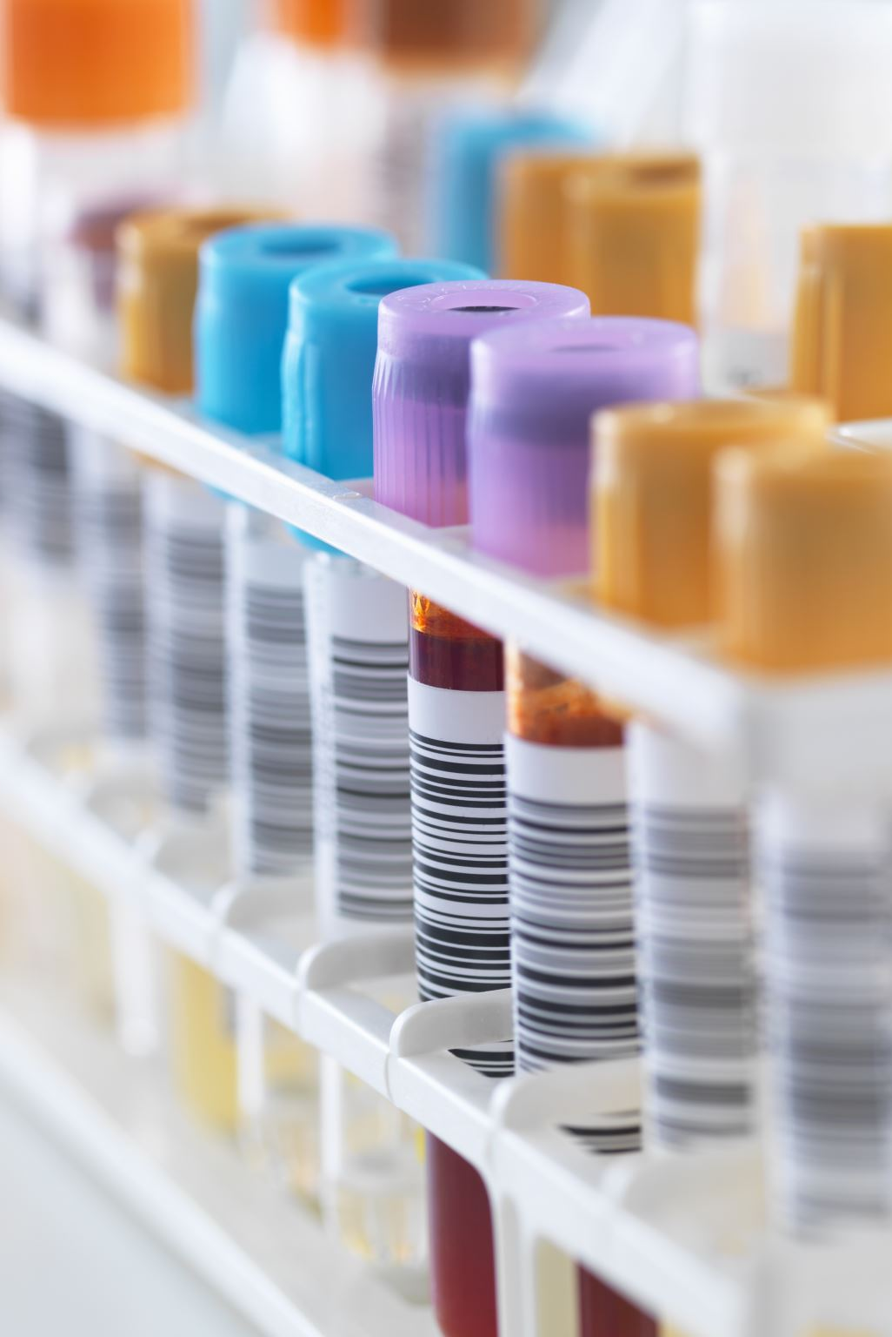
Control Procedure
The Positive and Negative Controls must be run with each assay. Additional QC testing may be performed by the operator by the inclusion of other characterised specimens or reference material.
The Positive Control should produce a positive result and the Negative Control should produce a negative result with the test. When the Kit Positive is titrated, the expected end point is 1/640 – 1/2560. If the appropriate results are not obtained with the controls, the assay is considered invalid and all samples within that assay should be retested.
TPHA Controls are pre-diluted. They should be added directly to the reaction well without being diluted in TPHA Sample Diluent. Test Cells are added directly to the Controls.

Slide 5
Titration Scheme for Positive Control
Tube # | 1 | 2 | 3 | 4 | 5 | 6 | 7 | 8 | 9
Diluent |  |  |  | 25µL | 25µL | 25µL | 25µL | 25µL | 25µL
Pos Control 1:20 (pre-diluted |  | 25µL | 25µL | 25µL
25µL
25µL
25µL
25µL
25µL
Tube # | 1 | 2 | 3 | 4 | 5 | 6 | 7 | 8 | 9
Serum Dilution |  | 1:20 | 1:20 | 1:40 | 1:80 | 1:160 | 1:320 | 1:640 | 1:1280
Control Cells |  | 75µL
Test Cells |  |  | 75µL | 75µL | 75µL | 75µL | 75µL | 75µL | 75µL
Final Dilution |  | 1:80 | 1:80 | 1:160 | 1:320 | 1:640 | 1:1280 | 1:2560 | 1:5120

Slide 6
Titration Scheme for Patient Serum
Tube # | 1 | 2 | 3 | 4 | 5 | 6 | 7 | 8 | 9
Diluent | 190µL |  |  | 25µL | 25µL | 25µL | 25µL | 25µL | 25µL
Patient serum/plasma | 10µL
25µL
25µL
25µL
25µL
25µL
25µL
Tube # | 1 | 2 | 3 | 4 | 5 | 6 | 7 | 8 | 9
Serum Dilution | 1:20 | 1:20 | 1:20 | 1:40 | 1:80 | 1:160 | 1:320 | 1:640 | 1:1280
Control Cells |  | 75µL
Test Cells |  |  | 75µL | 75µL | 75µL | 75µL | 75µL | 75µL | 75µL
Final Dilution |  | 1:80 | 1:80 | 1:160 | 1:320 | 1:640 | 1:1280 | 1:2560 | 1:5120

Slide 7
Interpretation of Results
A sample where the Test Cell well is non-reactive should be considered as negative for T.pallidum antibodies.
Reactivity less than equivocal is considered negative.
A sample where the Test Cell well is reactive or equivocal indicates antibodies to T.pallidum resulting from a syphilis infection. The sample should be repeated in duplicate. Where either repeat duplicate result is reactive or equivocal the sample should be considered as positive for T.pallidum antibodies. Where both duplicate repeat results are non-reactive then the samples is determined as non-reactive.
Where a sample is reactive in both Test and Control Cells, if the agglutination is greater in the Test Cells then the sample is considered positive and should be repeated as above.
When running the sample titration procedure, a titre of ≥ 1/80 is considered reactive and the sample should be repeated in duplicate.
Reactive results may indicate active, past or successfully treated syphilis infections

Slide 8
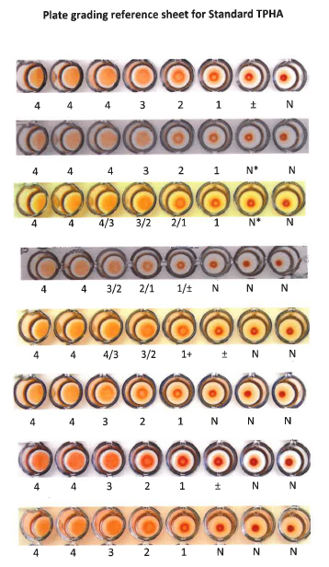
Interpretation Guide
* Scored as N as they lack the characteristic soft edges of a ±

Slide 9

Further Reading
www.newbio.com

